Slide 1
SPREADSHEETS
1

Slide 2
Working with numbers

Slide 3
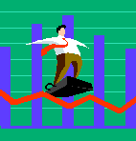
What is a Spreadsheet
A Spreadsheet is an application to organise and manipulate numbers
Spreadsheets are used for
Accounting
Sales
Financial Management
Budgets
Track Expenditure
Learners school marks
Invoices
Making Graphs

Slide 4
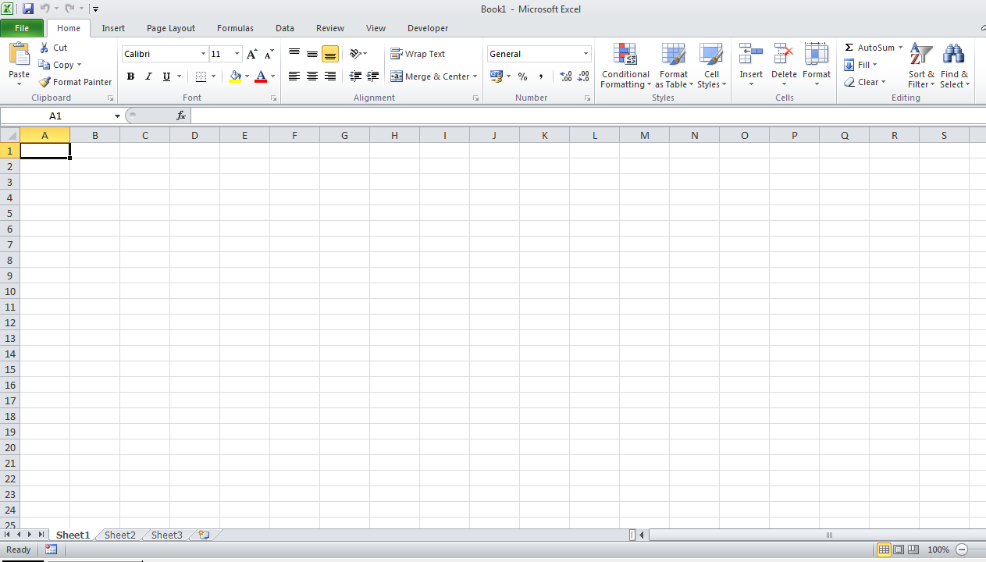
SPREADSHEET
Columns
Rows
Functions

Slide 5
Advantages of Spreadsheets
You can present your data in graphs
Excel can be integrated in Word, PowerPoint and Access
Confidential data can be hide in a spreadsheet
You can lock some data so that people can’t change it
There is hundreds of functions to choose from

Slide 6
Advantages of Spreadsheets
When you change data in the spreadsheet the results will automatically change if used in other packages, it is called automatic re-calculations, very powerful feature
You can change the number formatting to date, Currency, Time, Text, Accounting

Slide 7
Activity
The teacher will hand out fun activities

